Slide 1
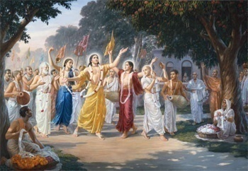
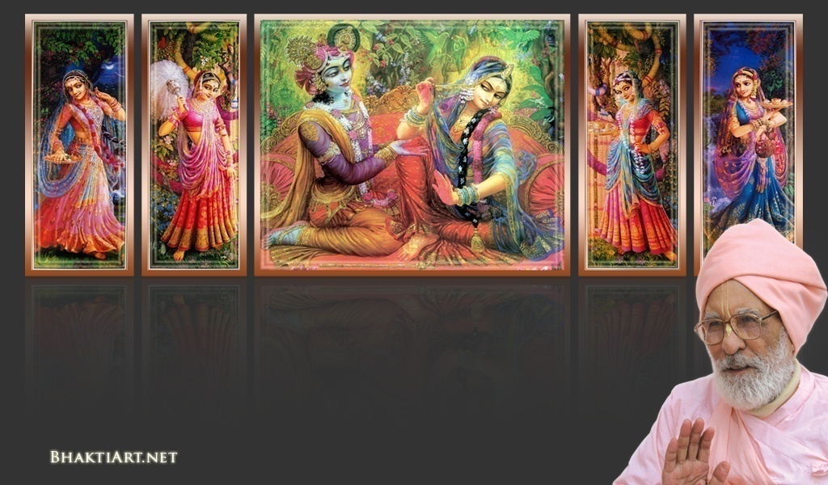
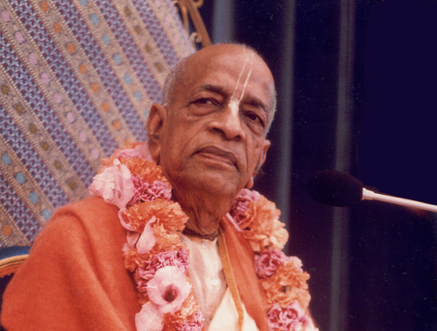
Sri Krsna Caitanya Prabhu Nityananda
Sri Advaita Gadadara Srivasadi
Gaura Bhakta Vrinda
Week 333
Jan 16 2015
Hare Krsna Hare Krsna
Krsna Krsna Hare Hare
Hare Rama Hare Rama
Rama Rama Hare Hare
Gokul Bhajan & Vedic Studies
North Carolina, USA
Notes:
Om Ajnana timirandhasya, jnananjana salakaya
Caksur unmimiltam yena, tasmai sri gurave namah
Namah om vishnu padaya, radhikayah priyatmane
Sri-srimad bhaktivedanta, narayana iti namine
Sri krishna lila kathane sudaksham
Audarya-madhurya gunais ca yuktam
Varam varenyam purusham mahantam
Narayanam tvam sirasa namami
He krishna karuna sindho, dina bandho jagat pate
Gopesha gopika kanta, radha kanta namo ‘stu te
tapta kancana gaurangi, radhe vrindavaneshvari
vrsabhanu sute devi, pranamami hari priye
bhajami radham aravinda netram
smarami radham madhurasmi-tasyam
vadami radham karuna bharardram
tato mam anyasti gatir na kapi
bhaktya vihina aparadha lakshai
ksiptas ca kamadi taranga madhye
krpamayi tvam saranam prapanna
vrinde numas te caranara vindam
--------------------------
First of all, I pay my koti dandavat pranams to my diksha guru Om vishnupada rupanuga acharya Sri Sri Bhakti Vedanta Narayana Goswami maharaja.
My dandavat pranams to Sri Sri Bhakti Vedanta Swami Prabhupada, and guru varga.
My humble pranams at the lotus feet of all assembled devotees, vaishnavas and vaishnavis..

Slide 2
Tilak
The Divine
Symbol

Slide 3
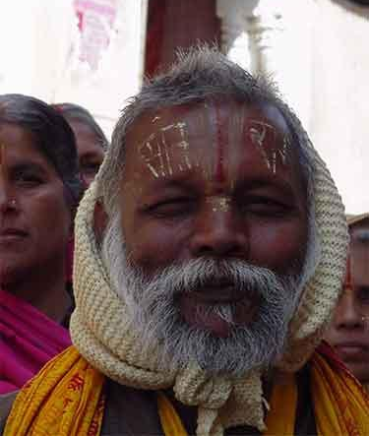
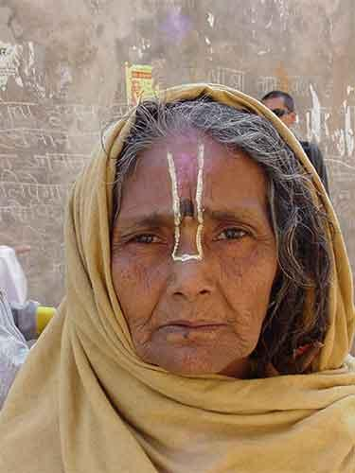

Slide 4
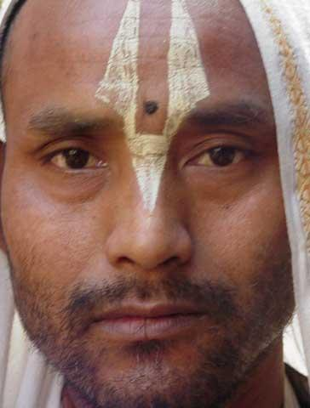
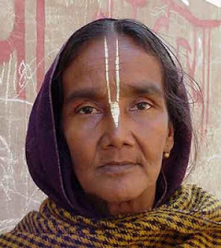

Slide 5
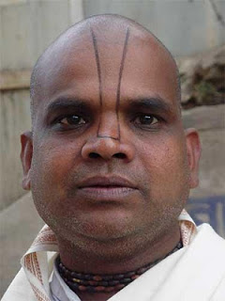
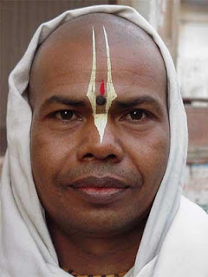
Notes:
Arjuna (pandavas) were victorious!
Actually in his heart he felt that he was actually the cause of Victory!
When Krishna was leaving to His dham, Arjuna’s powers were also gone!
He could not even shot an arrow!

Slide 6
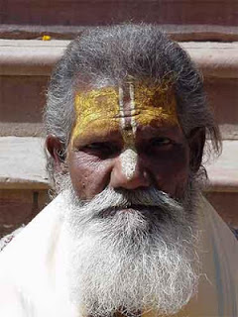
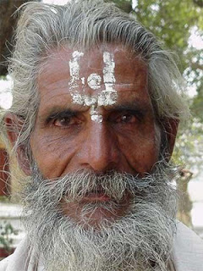

Slide 7
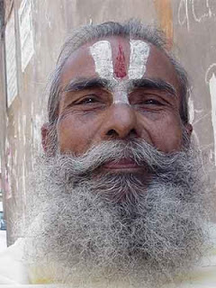
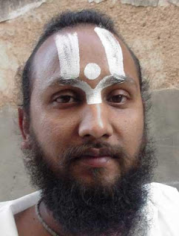

Slide 8
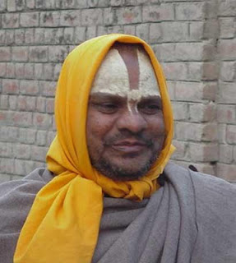
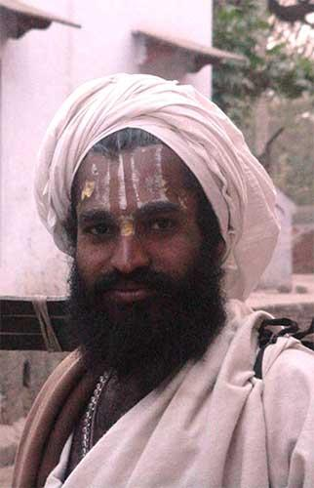

Slide 9
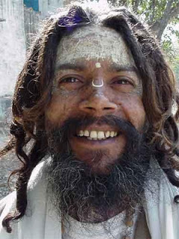
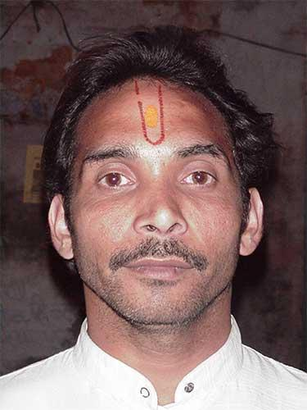

Slide 10
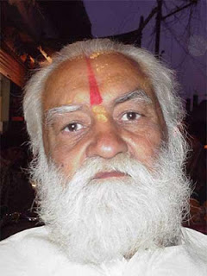
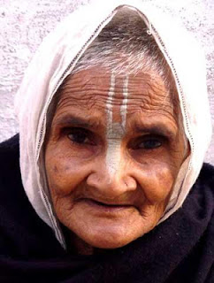

Slide 11
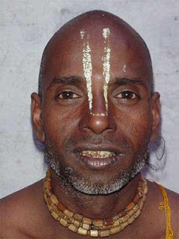
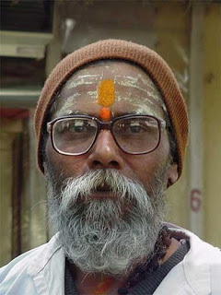

Slide 12
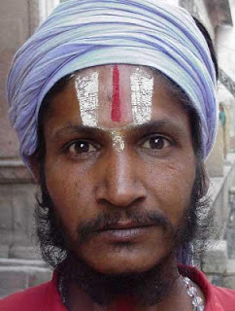
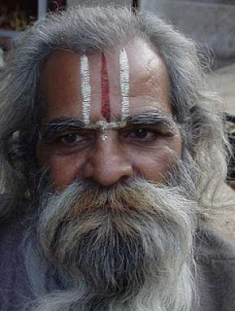

Slide 13
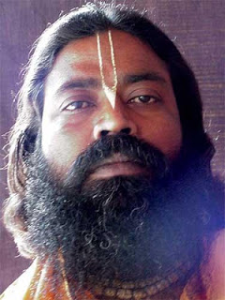
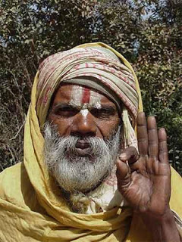

Slide 14
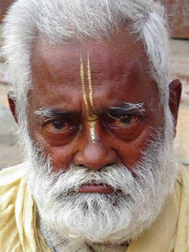
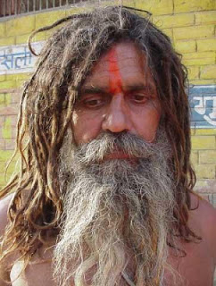

Slide 15
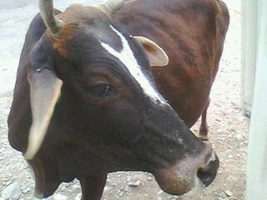
Notes:
What is Evolution?
It is taught in the schools as scientific fact..
It was propunded by Darwin.
It is similar to the theory of vaccination – an incomplete work by Louis Pastor.
Please listen to this video on Evolution very carefully..

Slide 16
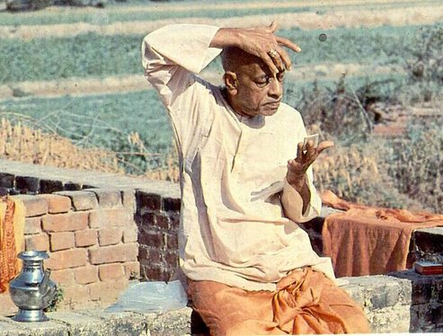
Why do we need to wear Tilak?

Slide 18
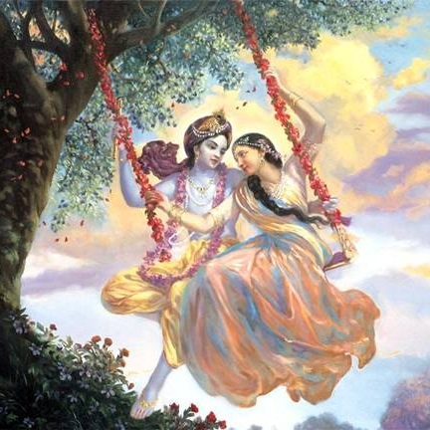
Jaya Rādha Mādhava
Jaya Kunja Vihārī
Jaya Gopī Jana Vallabha
Jaya Giri Vara Dhārī ... (Jaya)
Yaśodā Nandana Vraja Jana Ranjana
Yamunā tīra Vana Cāri ... (Jaya)
[ Hare Krishna Hare Krishna
Krishna Krishna Hare Hare
Hare Rāma Hare Rāma
Rāma Rāma Hare Hare ]

Slide 19
Tilak
The Divine
Symbol

Slide 20
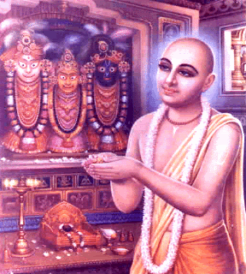
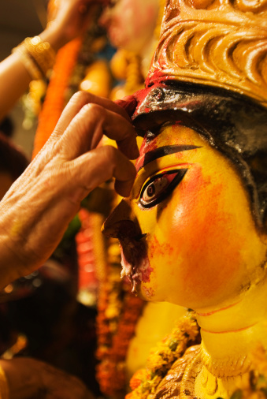
Our body is a temple of Krishna. He is the real owner of us and our body.
Notes:
When one sees Tilak on a devotee, he will think about Krishna.
This will increase his spiritual awareness.

Slide 21
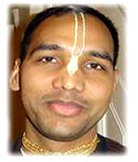
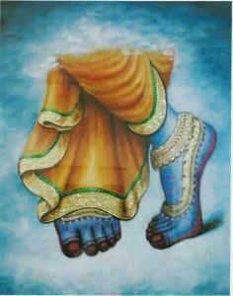
What does Gopi Chandan Tilak represent?
Notes:
TILAK represents the foot print of Lord Krishna, or Lord Narayana.
The bottom has Tulasi leaf.

Slide 22
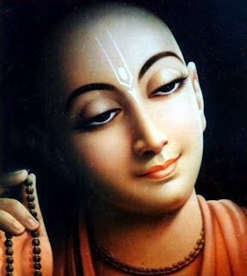
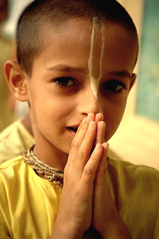
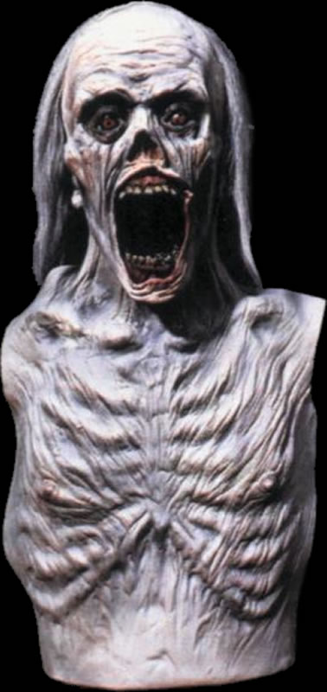
Lord Caitanya: “Any one who does not have TILAK on the head is nothing but a corpse (dead body)”
Notes:
Lord Caitanya said, ’Any one who does not have a TILAK on the head is nothing but a corpse (dead body)”

Slide 23
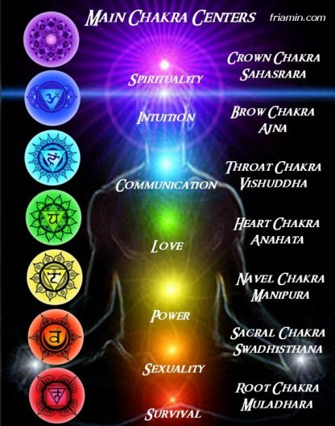
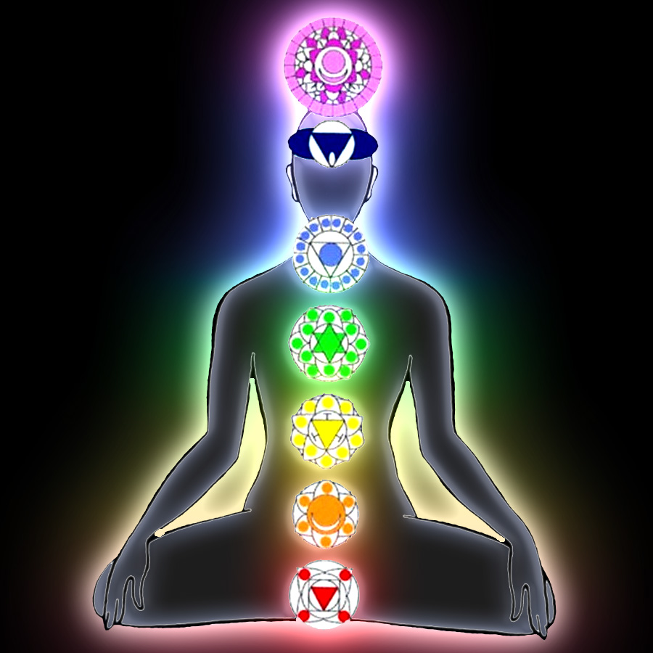
Where should be the main tilak worn?
Notes:
It should have the base in the AJNA Chakra..

Slide 24
Notes:
We mark our body in 13 places with Tilak.
What if I can’t wear to School?
Chant ‘Gange Ca Yamune Caiva..” mantra, and use GANGA WATER and put Tilak with Ganga Water.

Slide 25
Keshavāya Namah Nārāyanāya Namah
Mādhavāya Namah Govindāya Namah
Vishnave Namah Madhusudanāya Namah
Tri-Vikramāya Namah Vāmanāya Namah
Sridharāya Namah Hrshi-Keshāya Namah
Padmanābhāya Namah Dāmodarāya Namah
Vāsudevāya Namah Vāsudevāya Namah
Notes:
How do we wear Tilak?
By chanting 13 names of Lord Krishna while applying on 13 parts of our body.

Slide 26
Where and How do I wear Gopi Chandana?
Notes:
Where and How do I wear Gopi Chandana?

Slide 27
“One should mark the tilak on his forehead as follows: he should start from the nose tip and go till his kesa (hair). The width should be one angula (circa 1 inch). This is urdhva pundra laksana”. – Vasista Smrti
“Oh king of the birds (Garuda), if gopi-candana is marked on anyone's forehead by the mercy of the Supreme Lord, no planets (Sun, Moon, Mars, etc.), Yaksas (semi demigods), Pisacas (ghosts and devils), snakes and demons can harm him.”
- [Hari Bhakti Vilasa 4/238
from Garuda Purana spoken by Narada Muni]

Slide 28
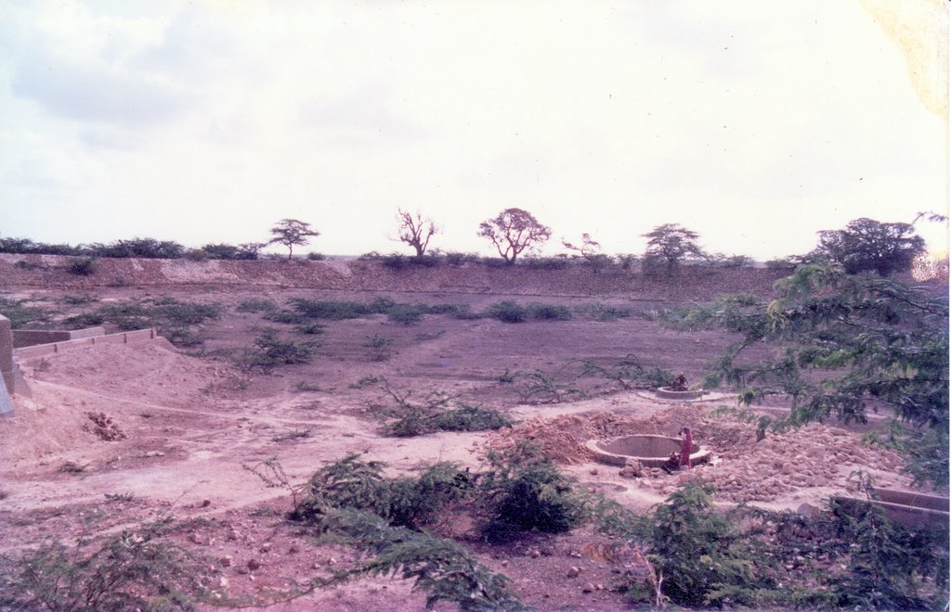
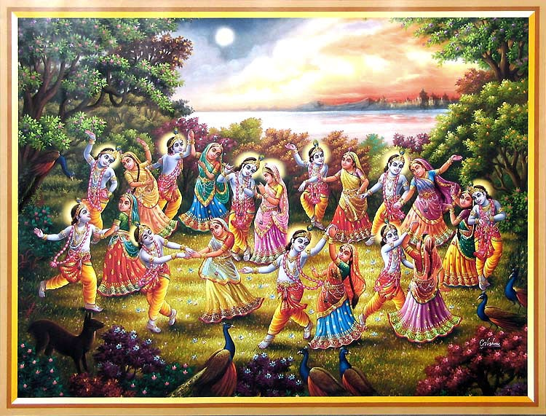
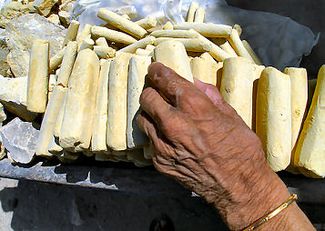
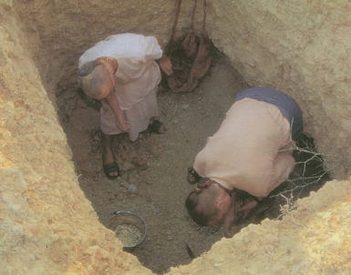
Yamuna
Dwaraka
Where does the Gopichandan Clay come from?
Notes:
Remember the DRAMA – GOPI CHANDEN??
Yamuna clay – and Vrindavan dust
Dwaraka – Gopichandan lake – Where all the bullock carts load was dumped

Slide 29
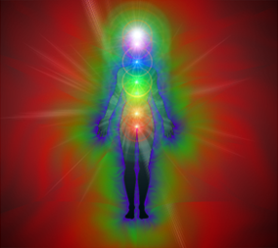
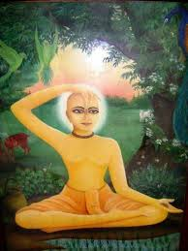
Scientists have found out one’s AURA changes when Tilak is applied!

Slide 30
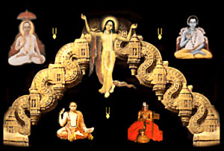
Notes:
Different Sampradayas have variations of Tilak.
Caitanya Mahaprabhu is the umbrella of all the 4 Sampradayas:
Sri
Brahma
Rudra
Four Kumara

Slide 31
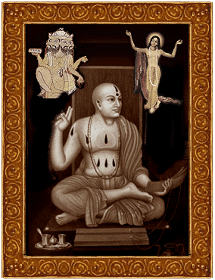
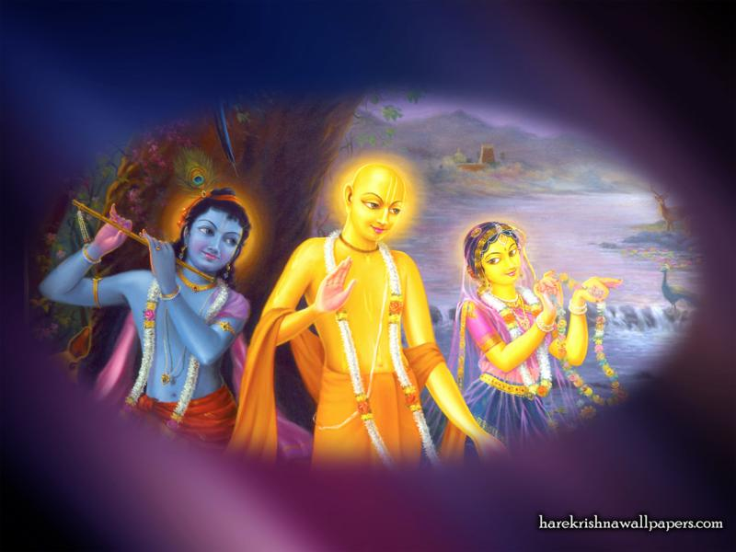
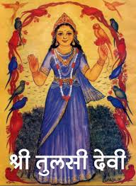
Brahma-Madhva Gaudiya Sampradaya
Feet of Radha Krishna
Brahma -> Madhva
Tulasi Leaf
Notes:
Sri Chaitanya Mahaprabhu
Sri Chaitanya Mahaprabhu (A.D. 1486-1534) also strongly opposed Shankara’s Mayavada philosophy of Adwaita and established the principle that took the previous acharya’s teachings to a new level, called achintya-bhedabheda-tattva. This specified that the Supreme and the individual soul are inconceivably and simultaneously one and different. This means that the Supreme and the jiva souls are the same in quality, being eternally spiritual, but always separate individually. The jivas are small and subject to being influenced by the material energy, while the Supreme is infinite and always above and beyond the material manifestation.
Sri Chaitanya taught that the direct meaning of the Vedic shastras is that the living entities are to engage in loving devotional service, bhakti, to the Supreme, Bhagavan Sri Krishna. Through this practice there can develop a level of communication between God and the individual by which God will lovingly reveal Himself to those who become qualified. In this understanding, the Vedic theistic philosophy of Vaishnavism reached its climax. Thus, Sri Chaitanya started what could be called a new philosophy that perfected the previously developed schools of thought, or united the basic principles of the othersampradayas.
Sri Chaitanya Mahaprabhu, who is considered and was established by Vedic scripture as the most recent incarnation of God, did not become much involved in writing. In fact, He only wrote eight verses called the Shikshastaka, but His followers compiled extensive Sanskrit literature that documented His life and fully explained His teachings. However, it is one of His followers, Baladeva Vidyabushana, who wrote a commentary on the Vedanta-sutras called Govinda-bhasya, meaning it is considered the commentary as given by the deity of Govinda.

Slide 32
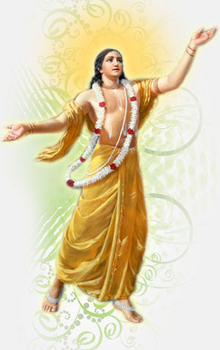
Caitanya Deva Namo Namo
Sarva Rakshakaa Namo Namo
Sankirtana Maya Prema Purushaa
Saci Suta Baalaa Namo Namo ... (Caitanya)
Svarna Varno Namo Namo
Chanda Naangadaa Namo Namo
Sanyaasa Krt Samah Saantah
Saanti Paraayanah Namo Namo ... (Caitanya)
Radhika Bhavanaa Namo Namo
Rakshaka Rupakaa Namo Namo
Raadhaa Krishna Samgata Rupaa
Raaja Sinhaave Namo Namo ... (Caitanya)
Kaanchana Deva Namo Namo
Krishna Govinda Namo Namo
Kaliyuga Taara Mantira Dhaana
Kaarunya Deva Namo Namo ... (Caitanya)

Slide 33
Sri (Ramanuja) Sampradaya
Laxmi (Sri)
Ramanuja
Notes:
Ramanuja
The main exponent of the Sri sampradaya, born in 1016 (some say in 1055), propagated the doctrine called visista-advaita, "oneness with varieties of the Lord and His energies".
His school is probably the most famous in south India and has various branches, all characterized by a particular Tilak (a mark on the forehead made with sacred clay and natural colors).
Ramanuja was deeply influenced by the devotional poetry of the south Indian mystics known as Alvars, and resided as a pujari or priest in the temple of Ranganatha or Srirangam (near modern Tirucchirapalli).
This philosophy states that the jiva (the individual soul) and the jagat (the material universe) depend on Isvara (the Supreme sa-guna Brahman, or Bhagavan), the only Reality. According to this philosophy, the individual soul can be either baddha (conditioned) or mukta (liberated). Jagat, the material world, is real and eternal, although manifested and withdrawn in cycles, meaning it is temporary.
This philosophical system is based on pramana ("epistemology, or evidence"), explained as pratyaksa (direct perception), anumana (deduction), and sabda (evidence from shastra or scripture, guru and sadhu). The eternal and natural knowledge (jnana svarupa) of the baddha soul is covered by ignorance, while the liberated soul resides in Vaikuntha. The difference is total surrender (prapatti) in bhakti (love and devotion) to God.
God manifests in five forms as Para (the transcendental form), Vyuha (the divine manifestations that originate Reality), Vibhava (the avataras), Archa (the Deity form) and Antaryami (residing in the heart of each living entity and each atom).
Ramanuja wrote Vedartha sangraha (on the Vedas), Sri bhasya (on Vedanta), Bhagavad gita bhasya, Vedanta sara (a summary of Vedanta), Vedanta dipa (describing the subjects of Vedanta), Saranagati gadhya (prayers favoring surrender to Narayana), Sri Ranga gadhya (prayers in glorification of the holy city of Sri Ranga), Sri Vaikuntha gadhya (prayers glorifying Vaikuntha, the spiritual world), Nitya grantha (a manual for daily worship and rituals, including funeral and birth ceremonies).
Introductory works to his philosophy have been written by Srinivasa dasa (Yatindra mata dipika) and Bucchi Venkatacharya (Vedanta Karivadi).
He founded seventy-four centers of Sri Vaishnavism and initiated seven hundred sannyasis (renounced monks), twelve thousand brahmacharis (celibate students), and thousands of householders, including kings and wealthy landowners.
Ramanuja is said to have visited Puri during the reign of Choda Ganga Deva. Tradition says that he tried to convince the priests of Jagannatha temple to stop the tantric style of puja they were following.
However, while he was sleeping in the night he was carried away to the bank of river Bhargavi by Garuda himself. He failed to introduce his worship system also in Trivandrum (the temple of Ananta Padmanabha), but he succeeded in Tirupati, substituting the texts known as the Vaikhanas agamas with the Pancaratra agamas. In Puri he founded the Emar Math.

Slide 34
Vishnuswami (Vallabhacharya) Sampradaya
Rudra
Vishnuswami
Vallabhacharya
Notes:
Vishnuswami
The fourth Vaishnava acharya, Vishnusvami, representative of the Rudra sampradaya (who worship the avatara of God known as Narasimhadeva) is less known than the other three.
Actually there is some confusion about him, as it seems there have been three Vishnu Svamis: Adi Vishnu Svami (around 3rd century BCE, who introduced the traditional 108 categories of sannyasa), Raja Gopala Vishnu Svami (8th or 9th century CE), and Andhra Vishnu Svami (14th century).
The emphasis of this school, called suddha-advaita ("pure monism"), is on the concept of lila or the pastimes by which God can be transcendental and immanent according to His will. Thus everything is pure, including the material universe, that is created by God and intimately related to Him. In his method of worship, Vishnusvami gives preeminence to Rama, the previous avatara before Krishna.
Vishnusvami visited Puri and founded there the Jagannatha Vallabha Math in the gardens of the temple, where Ramananda Raya also established his spiritual school.
Among the famous followers of this sampradaya we can mention Sridhara Svami (who became famous for his commentary on the Bhagavata purana).

Slide 35
Nimbarka Sampradaya
Four Kumaras
Sanaka (ancient),
Sanatana (eternal),
Sanandana (joyful) and
Sanatkumara (Ever Young)
Notes:
Nimbarka
The main exponent of the Kumara or Chatuhsana sampradaya (this knowledge was transmitted to the four Kumaras by the Hamsa avatara), who lived in the 13th century and propagated the doctrine calleddvaita advaita, "simultaneous oneness and duality".
Nimbarka presents himself as a disciple of Narada Muni and says that for a period of his life he lived in Naimisharanya.
This philosophical school has centers in the area of Mathura-Vrindavana (Nimbarka was born near Govardhana from a family of Telugu brahmanas), Rajasthan and Bengal, and identifies the Supreme Brahman as the divine couple of Radha and Krishna.
The identification between the savisesha (with form) and nirvisesha (without form) aspects of Bhagavan (the Supreme Person) is called svabhavika-bheda-abheda, "natural difference and oneness", as he sees no contradiction. The two categories of jivas as baddhas (materially conditioned) and muktas (liberated) are temporary as a baddha jiva can become a mukta through the path to realization or sadhana, which is bhakti (the path of devotion) that includes both karma (the knowledge of action and reaction and becoming free from karma) and jnana (cultivated knowledge). The first stage is karma (the ritualistic process), the second is jnana (the cultivation of knowledge), the third is dhyana (meditation), the fourth is prapatti (surrender), and the fifth is guru prapatti (complete dedication to the instructions of the guru).
His most famous works are the Vedanta Parijata Saurabha (commentary to the Vedas and Upanishads), Sadachar prakash (a treatise on Karma kanda), a Gita bhasya (commentary on the Bhagavad-gita),Rahasya sodasi (explanation of the Sri Gopala mantra), Krishna stava raja (establishing the supreme position of Krishna), Prapanna kalpa valli (explanation of Mukunda mantra), Prata smarana stotram (a devotional poem), Kamadhenu Dasa sloki ("ten nectarine verses" about the meditation on Radha Krishna).

Slide 36
Brahma (Madhva) Sampradaya
Brahma
Madhvacharya
Notes:
Madhva
The main exponent of Brahma sampradaya, born in 1238 (some say in 1199), propagated the philosophy called Dvaita or Visistha Dvaita ("duality with differences", or "different differences"). The center of the Madhva school is Udupi, the birthplace of Madhva.
According to this philosophy, there is a substantial distinction between Isvara (God), jiva (individual soul) and jagat (material energy). Isvara is always independent (sva-tantra) while the jivas (souls), prakriti(material energy), kala (time), karma (reactions to activities), etc., are dependent realities (para-tantra). Such differences are elaborated in five categories (pancha-bheda) as between Isvara and jiva, Isvara and jada(prakriti), jiva and jiva, jiva and jada, jada and jada (or between an object and another).
These five differences are eternal, although jagat can be sometimes manifest (vyakta) and sometimes not manifest (avyakta). Jivas are also eternally categorized in three groups as sattvik (who can attainmukti or liberation), rajasik (destined to remain in samsara or cycles of birth and death, but with the possibility of making progress) and tamasik (hopelessly destined to hell or darkness).
Another perspective on the various differences explained by Madhva is the sajatiya, vijatiya and svagata: respectively the differences between different categories of objects, the differences between objects in the same category, and the differences within the parts of one specific object.
The collection of the 37 books written by Madhva (called sarva-mula) is divided in four groups:
1. prasthana traya, including two commentaries on Bhagavad-Gita, ten on Upanishads, four on Vedanta sutras, and one on Rig Veda.
2. dasa prakarana, ten short books explaining the points of Madhva's doctrine; the most important is the Vishnu tattva vinirnaya, detailing the characteristics of the atman (individual soul) and establishing Vishnu's supremacy.
3. smriti prasthana, commentaries on Bhagavata Purana and Mahabharata.
4. pomes and essays about rituals and sannyasa (renounced order of life).

Slide 37
Glories of Tilak
From Garga Samhita – Sixth Canto

Slide 38
Garga Samhita
Text 16
gopy-angaraga-sambhutam gopi-candanam uttamam gopi-candana-liptango gangā-snāna-phalam labhet
In Gopi-bhumi gopi-candana was manifested from the gopīs' cosmetics. A person who marks his limbs with gopi-candana Tilak attains the result of bathing in the Ganga.

Slide 39
Garga Samhita
Text 17
mahā-nadinām snānasya puņyam tasya dine dine gopi-candana-mudrābhir mudrito yah sadā bhavet
A person who daily wears gopi-candana Tilak attains the pious result of daily bathing in all sacred rivers.

Slide 40
Garga Samhita
Text 21
gopi-candana-liptāngam yadi pāpa-satair yutam tam netum na yamah sakto yama-dutah kutah punah
Even if in the past one has committed hundreds of sins, if the person wears gopi-candan Tilaka, Yamarāja cannot take him away. How can then Yamarāja’s messengers touch him?

Slide 41
Garga Samhita
Text 22
nityaṁ karoti yah pāpī gopi-candana-dhāraņam sa prayati harer dhāma golokam prakrteh param
Even a sinner who daily wears gopi-candan Tilaka goes to Lord Kṛṣṇa's abode, Goloka, which is beyond the world of matter.

Slide 42
Garga Samhita
sindhu-desasya rājabhud dirghabahur iti srutah anyaya-varti dustātma vesya-sanga-ratāh sadā
Notes:
In Sindhu-desa there was a king named Dirghabahu. He was cruel and sinful and he was addicted to very bad habits.
He had committed all the crimes one can think of.

Slide 43
tena vai bhārate varse brahma-hatya-satām krtam dāsa garbhavati-hatyah krtas tena durātmana
Notes:
While he was on the earth this cruel sinner murdered a hundred brāhmaṇas and ten pregnant women.

Slide 44
Garga Samhita
mrgayāyam tu banaughaih kapila-go-vadhāh krtah saindhavam hayam āruhya mrgayarthi gato 'bhavat
Notes:
One day he mounted a sindhu horse and went hunting.

Slide 45
mrgayāyam tu banaughaih kapila-go-vadhāh krtah saindhavam hayam āruhya mrgayarthi gato 'bhavat
Notes:
With a flood of arrows, he also accidentally killed a brown cow in that hunt.

Slide 46
ekada rājya-lobhena mantri kruddho mahā-khalam jaghanāranya-dese tām tiksna-dharena cāsina
Notes:
Later one day, greedy to get his kingdom, with a sharp sword his angry minister killed him in the forest.

Slide 47
Notes:
The king fell on the ground and died...

Slide 48
Notes:
Seeing this, waiting for his death anyway, the Yama Dhutas immediately rushed to the spot.
They tied the king’s soul with rope and took him to the courst of Yama.

Slide 49
Citra Gupta
Notes:
Seeing this sinner brought before him, powerful Yamarāja said to his scribe Citragupta, "What is the proper punishment for him?“
Who is Citra-Gupta?
He keeps record of every one of our activities!!
NO ONE can escape from his record!!!!

Slide 50
Notes:
Citra Gupta looked at all the records to see what he had done in his life..
It was all full of sinful actions – not even a single good thing!

Slide 51
Notes:
Śrī Citragupta said: O Yama Raja, he should be thrown into eight million four hundred thousand hells for as long as the sun and the moon shine in the sky.
On the earth he did not perform a single pious deed. He killed ten pregnant women. He killed a brown cow.
He killed thousands of deer in the forest. He offended the demigods and the brāhmaṇas. He is a great sinner.

Slide 52
Notes:
by Yamarāja’s order, the Yamadutas took that sinner and threw him into a terrible, eight-thousand mile wide cauldron of bubbling boiling oil in the hell of Kumbhipaka.

Slide 53
Notes:
But the moment that sinner thrown into it, the boiling oil, which was as hot as the great fires at the time of cosmic devastation, suddenly became cool.
That sinner was not hurt by the boiling oil. Then the Yamadutas described that great wonder to noble-hearted Yamarāja.

Slide 54
Notes:
Yamarāja and Citragupta carefully reviewed the sinner's case again!

Slide 55
Notes:
They all looked and reviewed all the records and concluded that while he was on the earth the sinner had not for a moment performed even a single pious deed.!!!

Slide 56
Notes:
Then Vyasadeva arrived in that assembly.
Bowing down before Him, and carefully worshiping Him, saintly and noble-hearted Yamaraja asked Vyasadeva.
Sri Yamaraja said to Vyasadeva: When a certain sinner, who had never performed even a single pious deed, was thrown into the terrible boiling oil of Kumbhipaka, the oil suddenly became cool. Because of this my mind is now tortured with doubts.

Slide 57
Notes:
Vyasadeva found out the reason!
He said,”O this sinner died in a place where from someone's hand some gopi-candana from Dvaraka had accidentally fallen....

Slide 58
Notes:
... Dying in gopi-candana, that sinner became purified.!!!”
A person who wears gopi-candana Tilak attains a spiritual form like that of Lord Narayana.
Simply by seeing him one becomes free of the sin of killing a brahmana.

Slide 59
Notes:
Yamaraja, who understands the glories of gopi-candana, took the sinner, placed him on an airplane that goes anywhere one wishes, and sent him to Vaikuntha, which is above all the worlds of matter.

Slide 60
Garga Samhita
Text 45
gopi-candana-mahātmyam yah srnoti narottamah sa yati paramam dhāma sri-krsnasya mahātmanah
One who hears this account of gopi-candana's glories becomes exalted. He goes to the supreme abode of Lord Krsna.

Slide 61
Base of Tulasi Devi is also same as Gopi Chandan
Notes:
Saints are always residing at the foot of Tulasi devi..
The dust at the root of Tulasi is Gopichandan.

Slide 62
A Glorious TILAK in History
Notes:
Syamananda Pandit is a great devotee and Acharya in the line of Lord Caitanya.
His initial name was ‘Dhukhi’ and later initiated as Dhuki Krishna Das by Sri Hridaya Caitanya Adhikari,
a disciple of Sri Gauri Dasa Pandit (Subhal Sakha of Vraj).

Slide 63
Notes:
He visited Vrindavana as per the instruction from his GURU.
Then he returned back to his place in bengal.
But he was hangering to get back to Vrindavan..
So, he came back again to stay there permanently.

Slide 64
Notes:
He met Jiva Goswami, Srinivasa Acharya and Narattama Das Thakura in Vrindavan!!
Took the shelter of Jiva Goswami.
Jiva Goswami assigned him the work on Cleaning Save Kunj!

Slide 65
Notes:
What is Seva Kunj?
This is part of the sacred Seva-Kunj area.
As you may know, even today there is a very strange thing about this place..
As soon as the evening bell rings, every one including monkeys, crows, insects everything leaves the place.
Any one who happen to be staying there at night will be found DEAD!
This is a mistery even today!
When cleaning and maintaining Seva Kunj, he witnessed many pastimes.

Slide 66
Notes:
Once in his vision he saw Sri Shyamasundar and Radha Rani were dancing with so many damsels of Goloka.
It looked like a moon dancing with stars.
During the dance, one of the anklets of Smt Radha Rani fell on the ground and when the dance was over, everyone hurried.
Smt Radha Rani and Gopis noticed that one of the anklets of Smt Radha rani was missing.

Slide 67
Notes:
Meanwhile Dhukhi Krishna Das ran to the place and noticed all the foot marks of the dance.
Controlling his ecsacy, he tried to continue cleaning the groves.
But he found the same anklet he saw in the vision near a pomogranite tree.
It did not appear to be belonging to this world. When it accidentally touched his grass-cutter, it became GOLD!
He took it and kept in in his cloth very securely.

Slide 68
Notes:
Soon, Gopis found out that an anklet of Radha Rani is missing.
Lalita disguised as a old lady appeared in front of him and asked about any anklet he found here.
Smt Radha Rani was hiding back of a bush and listening..
Dhuki Krishna Das told,”Yes I have found one studded with Indraneela Mani.. Indra-Kaanti . But I will give it only to the real owner”
Lalita said, “It belongs to my daughter in law who is always careless. Pl give it to me”
Dhuki Krsna das said, “No.. Your poor dress does not look rich.. Let me see the owner wearing the other anklet so that it will be a proof.”
Radha Rani noticed that Dhuki Krishna Das was more clever than Lalita!

Slide 69
Notes:
Then, Smt Radha Rani Herself appeared in person and said,
“O saint, that anklet belongs to me. Please give it to me!”
Dhuki Krishna Das realized the amazing mercy and asked,
“Oh damsels! I am not able to understand what is happening. Can you please reveal your real identity?”
Lalita Devi then showed her divine form and introduced Smt Radha Rani.
Dhuki Krishna Das was about to faint in ecstacy.
He said,”Please give me opportunity to serve Sri Radha Shyamsundar”.

Slide 70
Notes:
Radha Rani said,”You cannot serve us like this..”
Then Radha Rani told Lalita,”Give him My mantra and make him to take bath in Radha Kunda. He will become a manjari. Don’t delay..”
Radha Kunds manifested right there and
Lalita Devi dipped Dhukhi Krsna Das. Dukhi Krishna Das became a manjari.!
Radha Rani said,”In your previous birth you were Krishna-Priya and was my companion”
She also ordered Lalita, ‘O lalita, please give her the sign of My anklet on his forehead”

Slide 71
Notes:
Lalita did the same.
As soon as Lalita touched his forehead with the anklet, a beautiful permanent tilak appeared.
It was the foot of Smt Radha Rani.
Radha Rani said, “You are KANAK MANJARI. This my foot mark is known as Shyam Mohan Tilak.”

Slide 72
Notes:
Radha Rani then manifested a deity from Her heart, named Shyamasundar and gave to Dhuki Krishna Dasa.
“This is Syamsundar for you to worship and serve until you come back to Me.
From now on your name will be Syamananda”
The same deity is still worshipped in Vrindavan.

Slide 73
Notes:
He told the whole incident to Jiva Goswami who was extremely happy that his disciple got the mercy from the divine couple.

Slide 74
Temple in Vrindavan where Sri Radha Syamsundar deities are worshipped

Slide 75
Notes:
Syamanda Prabhu used to live in a nearby Cave, continuing to serve Seva Kunj and Sri Radha Syamasundar.
That same cave was discovered later in Vrindavan near the same temple.

Slide 76
Shyam Mohan Tilak
Notes:
His samadhi is is in Vrindavan.
The Tilak known as Shyam Mohan Tilak on the shape of the anklet of Smt Radha Rani is used by all the descendants of Shyamananda Pandit..

Slide 77
Notes:
Pastimes of Sri Radha Krishna are unlimited.
They all live in the hearts of rasika saints.

Slide 78
Notes:
REMEMBER we made a DRAMA of Gopis Stealing the Flute of Krishna?

Slide 79
Radha Rani, give me my flute!
My life resides in this flute
That flute got lost!
How do I sing and play?
How do I get my cows home?
My life resides in this flute?
That flute got lost!
Sing with your mouth
and play with your hands
Get your cows home with a stick!
I am holding your hands,
falling on your feet
Have pity on me!
Meera's lord Giridhar nagara
You finally took the flute!

Slide 80
Shri Radhe Rani, de daro na baansuri meri
Yaa bansi mein. pran basat hai
So bansi bhayi chori
Radhi Rani, So bansi bhayi chori ... (Shri)
Kahese gaaon Radhe, kahese bajaoon
Kahese laaon, gaiya gheri
Radhe Rani, kahese laaon, gaiya gheri ... (Shri)
Yaa bansi mein. pran basat hai
So bansi bhayi chori
Radhi Rani, So bansi bhayi chori ... (Shri)
Mukh se gaaon kanha haath se bajao
Lakuti se laaon gaiya gheri
Kanha more lakuti se laaon gaiya gheri...(Shri)
Haath dharat hoon tere paiya padat hoon
Taras khao Rani meri
Radhe Rani Taras khao Rani meri ... (Shri)
Meera ke prabhu giridhar naagara
Bansi lekar chodi
Kanha more bansi lekar chodi ... (Shri)

Slide 82
Let us Summarize..
Notes:
Tell all the 13 names of Lord Krishna when applying Tilak
What are the benefits of wearing Tilak?
A person who marks his limbs with Gopichandan attains the result of bathing in ______ (GANGA)
A person who wears Gopichandan attains the pious results of bathing in all _____ (SACRED RIVERS)
If one wears Gopichandan, _____ cannot take him (YAMARAJA)
One who wears Gopichandan goes to ____ (Goloka)
When wearing Tila, the base should be touching the position of _______ Chakra (AJNA)
Gopichandan represents the ________ of the Lord (FEET)
Lord Caitanya said,”If a person does not wear Gopichandan, he is equivalent to ____ (CORPSE)
Mud at the base of ________ is also same as Gopichandan (TULASI)
Initial name of Shyamanda Pandit was ____ (Dukhi KRSNA DAS)
Shyamananda Pandit found the missing Neela-mani (Chandra Kaanti) anklet of Radha Rani near a pomogranite tree in __________ (Seva Kunj / Nidhivan)
Who pressed the anklet on the forehead of Shyamananda Pandit to make a permanent Tilak? (LALITA)
The real identity (svarupa) of Shyamananda Prabhu was ____ (KANAK) manjari
Radha Rani manifested ______ deity from her and gave it to Shyamananda Pandit (Shyamasundar)

Slide 83
Identify the Sampradayas who wear them!
(1)
(4)
(2)
(3)
Why the black yagya mark of Madhva in the middle is missing in Madhva-Gaudiya?
(5)
Notes:
1) Vishnuswamy (Vallabhacharya)
2) Sri (Ramanuja & Ramanandi)
3) Madhva
4) Nimbarka
5) Madhva-Gaudiya

Slide 84
Homework Slokas!
OV-38-Gopi Chanda Liptangam
OV-39-Nityam Karoti Yah Papi

Slide 85
End of Episode
Tilak
The Divine
Symbol
Hare Krishna!
Thank You!

